Slide 1
Supervised learning/Machine learning for predictive models from training data

Slide 2


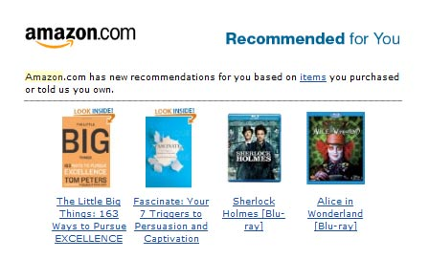
Machine Learning (ML)

Slide 3
Machine Learning using decision tree learning
Did someone survive the Titanic?
Notes:
Random Forests

Slide 4
Goal
Build a model from a set of categorized data points that can predict the correct category membership of unlabeled future data

Slide 5
response,
outcome,
dependent variables
Typical Data
predictors,
features,
attributes,
independent variables
Response may be continuous or categorical
Predictors may be
continuous, count, and/or binary
dense or sparse
observed and/or calculated

Slide 6
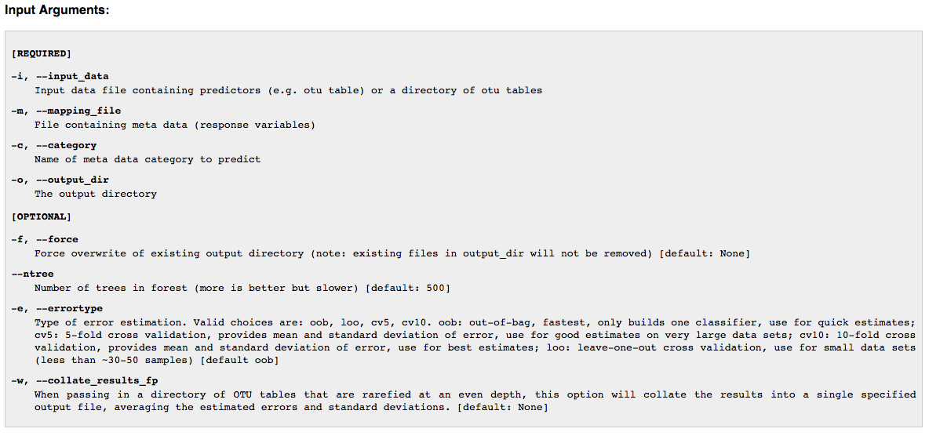
Options in QIIME
supervised_learning.py – Run supervised classification using OTUs as predictors and a mapping file category as class labels
Notes:
Validation is important to avoid overfitting. Want model to be generalizable to a new data set and to avoid trying to fit to outliers and noise. Split into training and testing. Curse of dimensionality. Training set may not need to be random, e.g. if you have multiple samples per individuals and some ind are IBD vs not. – want to take one sample from each individual into the training set.

Slide 7
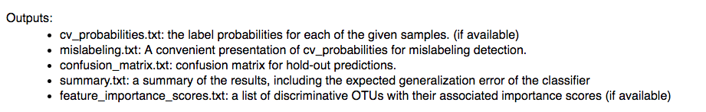
Feature Importance

Slide 8
Supervised regression
Supervised regression (e.g. time since death) not available in QIIME, but available in R (e.g. caret).
Metcalf et al. in press, Current Biology

Slide 9

Supervised regression

